Slide 1
Time Series Analysis of the Sunspot Cycle using the ARIMA and SARIMA Models
Insights and predictions of the count and density of sunspots.

Slide 2
Introduction
Sunspots are temporary phenomena on the Sun's photosphere that appear as spots darker than the surrounding areas. They are regions of reduced surface temperature caused by concentrations of magnetic field flux that inhibit convection. Sunspots usually appear in pairs of opposite magnetic polarity. Their number varies according to the approximately 11-year solar cycle. These spots are visible from the sun’s surface or “photosphere” and are known to appear as spots which are darker than surrounding areas of the sun. The layers of plasma from within and on the surface of the sun churning against one another at different rates (differential rotation) generates the sun’s very powerful magnetic field. This is the driving cause of not only sunspots, but plasma loops and solar flares as well. When a strong magnetic field disrupts the flow of plasma, sunspots begin to appear, which is typically the signal that a coronal mass ejection is soon approaching.

Slide 3
Dataset Details
I am using the Daily Sunspot Dataset from the World Data Center SILSO, Royal Observatory of Belgium, Brussels. The daily total sunspot number is derived by the formula: R = Ns + 10 * Ng, with Ns the number of spots and Ng the number of groups counted over the entire solar disk. The standard error of the daily Sunspot count can be computed by: sigma/sqrt(N) where sigma is the listed standard deviation and N the number of observations for the day.
The dataset has 8 columns. The first 3 columns are Year, Month and Day. Column 4 is fractional date. Column 5 is the daily count of sunspots. Column 6 is Daily standard deviation of sunspots. Column 7 is the # of observations and column 8 is definitive/provisional indicator.

Slide 4
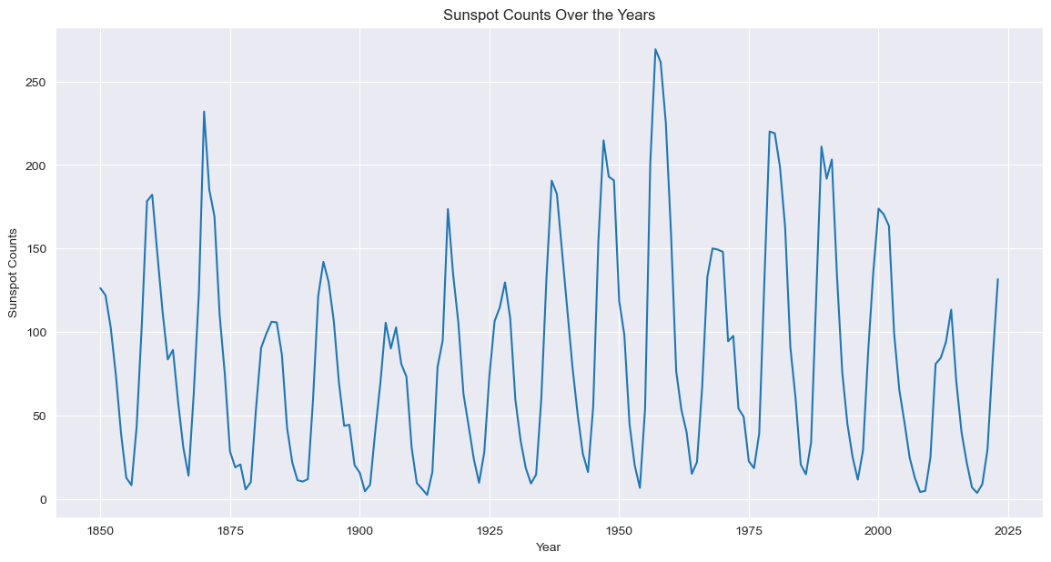
EDA
I initially graphed just the unprocessed data to visualize the basics of the dataset

Slide 5
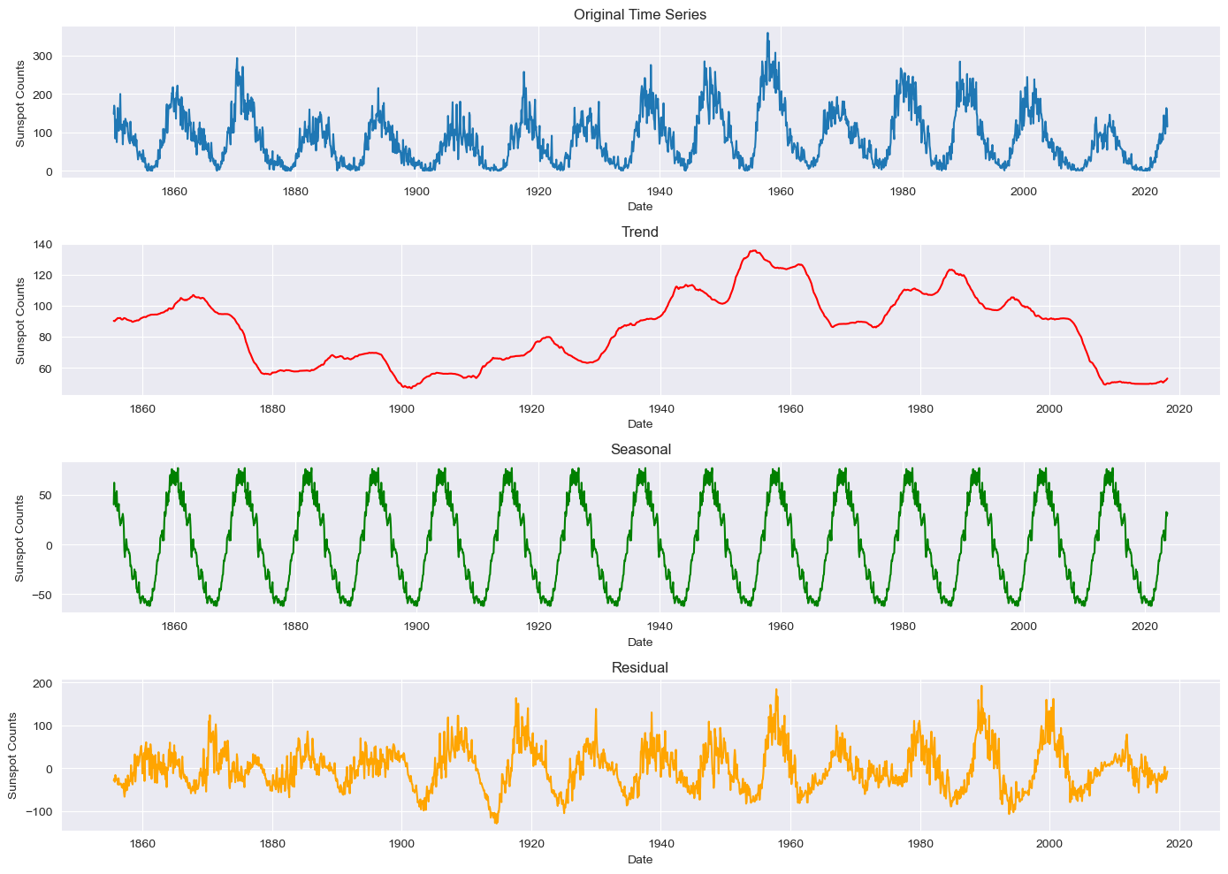
EDA
After cleaning up the dataset and graphing the original time series I performed a decomposition function to separate the trend, seasonal and residual components and graph them respectively. I then added a time column and replaced any NaN by linear interpolation. I then converted the counts column to a series.

Slide 6
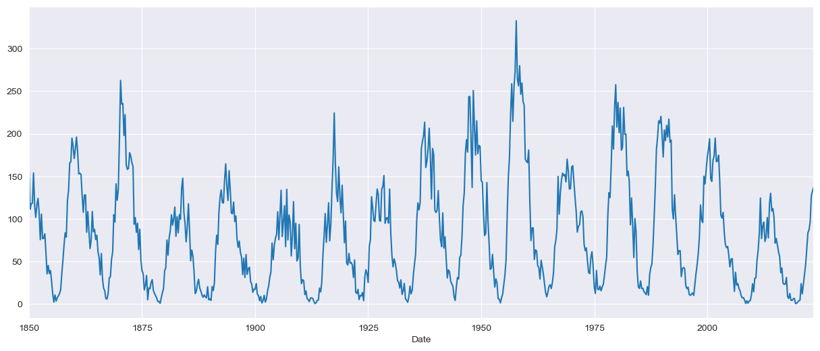
Data Preprocessing
I added a ‘Date’ column and set it as the index. I then made that a Series( named ‘ts’) and performed resampling for the mean of both the Month and the Quarter. I also split the dataset into a training and test sets as follows:
train = ts['1850-01-01':'2011-01-01']
test = ts['2011-01-02' : '2023-08-26']
This is the graph of the Series after making these transformations

Slide 7
Data Preprocessing
From the graphs of the decomposed time series I selected the values for (p=3,d=0,q=10) and (P=1, D=1, Q=0, S=43). ACF is positive at lag 43 AND P+Q≤2. ACF plot : Q=0 ACF is negative at lag 43 AND P+Q≤2. Then performed a Dickey-Fuller Test to check for stationarity.
Here the null hypothesis is that the TS is non-stationary. The test results consist of a Test Statistic and some Critical Values for difference confidence levels. If the ‘Test Statistic’ is less than the ‘Critical Value’, we can reject the null hypothesis and say that the series is stationary.

Slide 8
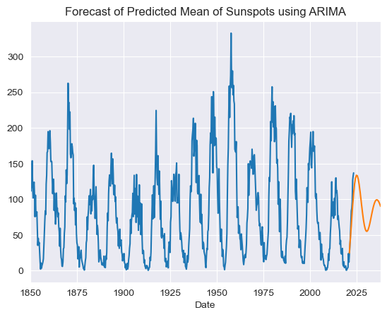
ARIMA model
Dep. Variable: counts No. Observations: 695
Model: ARIMA(3, 0, 10) Log Likelihood -3099.604
Covariance Type: opg
=============================================================
coef std err z P>|z| [0.025 0.975]
-----------------------------------------------------------------------------------
const 83.3876 5.999 13.901 0.000 71.631 95.144
ar.L1 1.0039 0.066 15.209 0.000 0.874 1.133
ar.L2 0.8298 0.124 6.689 0.000 0.587 1.073
ar.L3 -0.8748 0.064 -13.569 0.000 -1.001 -0.748
ma.L1 -0.3146 0.070 -4.492 0.000 -0.452 -0.177
ma.L2 -0.9428 0.089 -10.589 0.000 -1.117 -0.768
ma.L3 0.4160 0.043 9.569 0.000 0.331 0.501
ma.L4 0.1558 0.052 2.972 0.003 0.053 0.259
ma.L5 -0.0245 0.046 -0.534 0.593 -0.114 0.065
ma.L6 -0.0533 0.052 -1.016 0.309 -0.156 0.049
ma.L7 -0.0473 0.050 -0.951 0.342 -0.145 0.050
ma.L8 0.1086 0.055 1.972 0.049 0.001 0.217
ma.L9 0.0417 0.039 1.055 0.292 -0.036 0.119
ma.L10 -0.0965 0.041 -2.359 0.018 -0.177 -0.016
sigma2 435.7232 20.471 21.285 0.000 395.601 475.846
==============================================================
Ljung-Box (L1) (Q): 0.02 Jarque-Bera (JB): 53.85
Prob(Q): 0.89 Prob(JB): 0.00
Heteroskedasticity (H): 0.97 Skew: 0.34
Prob(H) (two-sided): 0.83 Kurtosis: 4.18
============================================================

Slide 9
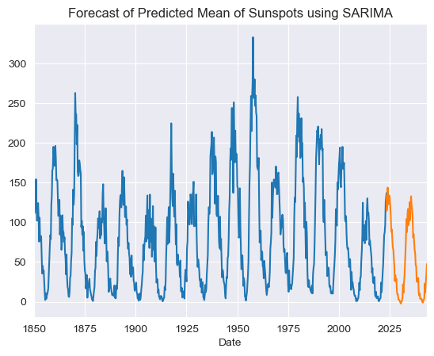
SARIMA model
Dep. Variable: counts No. Observations: 695
Model: SARIMAX(3, 0, 10)x(1, 1, [], 43) Log Likelihood -3031.596
Covariance Type: opg
=============================================================
coef std err z P>|z| [0.025 0.975]
-----------------------------------------------------------------------------------
ar.L1 0.9031 0.121 7.472 0.000 0.666 1.140
ar.L2 0.7916 0.169 4.675 0.000 0.460 1.124
ar.L3 -0.7522 0.104 -7.206 0.000 -0.957 -0.548
ma.L1 -0.2946 0.124 -2.381 0.017 -0.537 -0.052
ma.L2 -0.9234 0.135 -6.832 0.000 -1.188 -0.658
ma.L3 0.4243 0.054 7.855 0.000 0.318 0.530
ma.L4 0.1840 0.061 3.039 0.002 0.065 0.303
ma.L5 -0.0305 0.061 -0.498 0.618 -0.150 0.089
ma.L6 -0.0927 0.053 -1.737 0.082 -0.197 0.012
ma.L7 -0.0536 0.052 -1.023 0.306 -0.156 0.049
ma.L8 0.1807 0.051 3.540 0.000 0.081 0.281
ma.L9 0.0499 0.050 0.994 0.320 -0.049 0.148
ma.L10 -0.1232 0.050 -2.456 0.014 -0.222 -0.025
ar.S.L43 -0.4548 0.031 -14.626 0.000 -0.516 -0.394
sigma2 626.2016 31.424 19.928 0.000 564.612 687.791
==============================================================
Ljung-Box (L1) (Q): 0.02 Jarque-Bera (JB): 17.14
Prob(Q): 0.90 Prob(JB): 0.00
Heteroskedasticity (H): 1.18 Skew: -0.02
Prob(H) (two-sided): 0.22 Kurtosis: 3.79b
============================================================

Slide 10
Conclusion
As we can see from the results of our models against our test data as well as from the graphs the SARIMA model performs better than the ARIMA model. This information will be passed on to my client, Acme Telecommunications for use to better predict the occurrences of solar flares.

